Slide 1


Idaho Broadband
Advisory Board Meeting
Ramón S. Hobdey-Sánchez
Director
Idaho Office of Broadband
Wednesday, March 25, 2026

Slide 2

Agenda
BEAD Program Update
CPF Program: Latah County Project

Slide 3
BEAD Program
NIST Approval: 1.26.26
Interactive BEAD Award Dashboard
Partners/Consultants (MBI and BMC)
BEAD Subgrantee Kickoff: 3.24.26
Building project agreements
Environmental work/permitting
BEAD Subgrantee Agreements completed by July
Program Focus = Administration, Compliance and Project Management

Slide 4
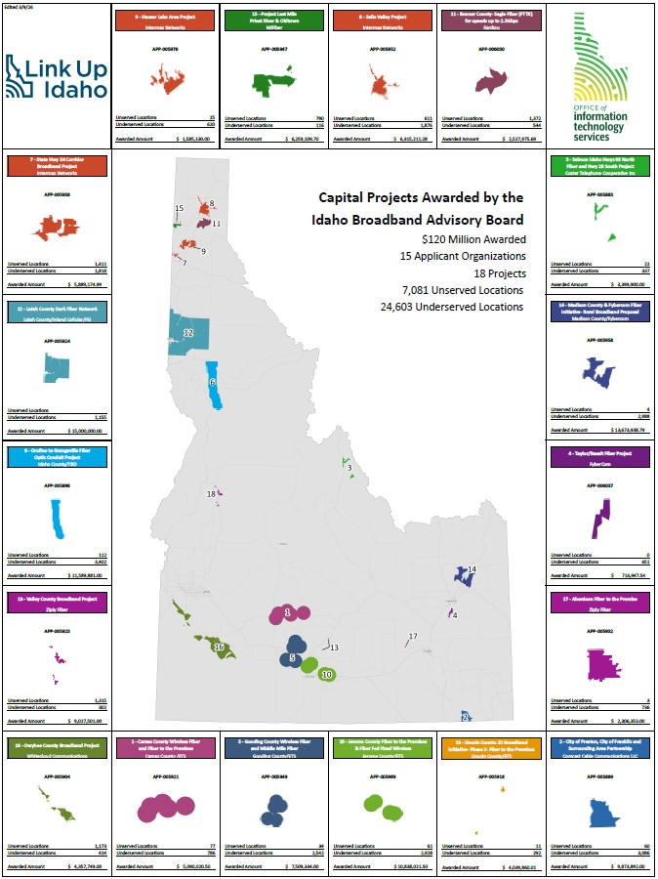

CPF: Latah County

Slide 5
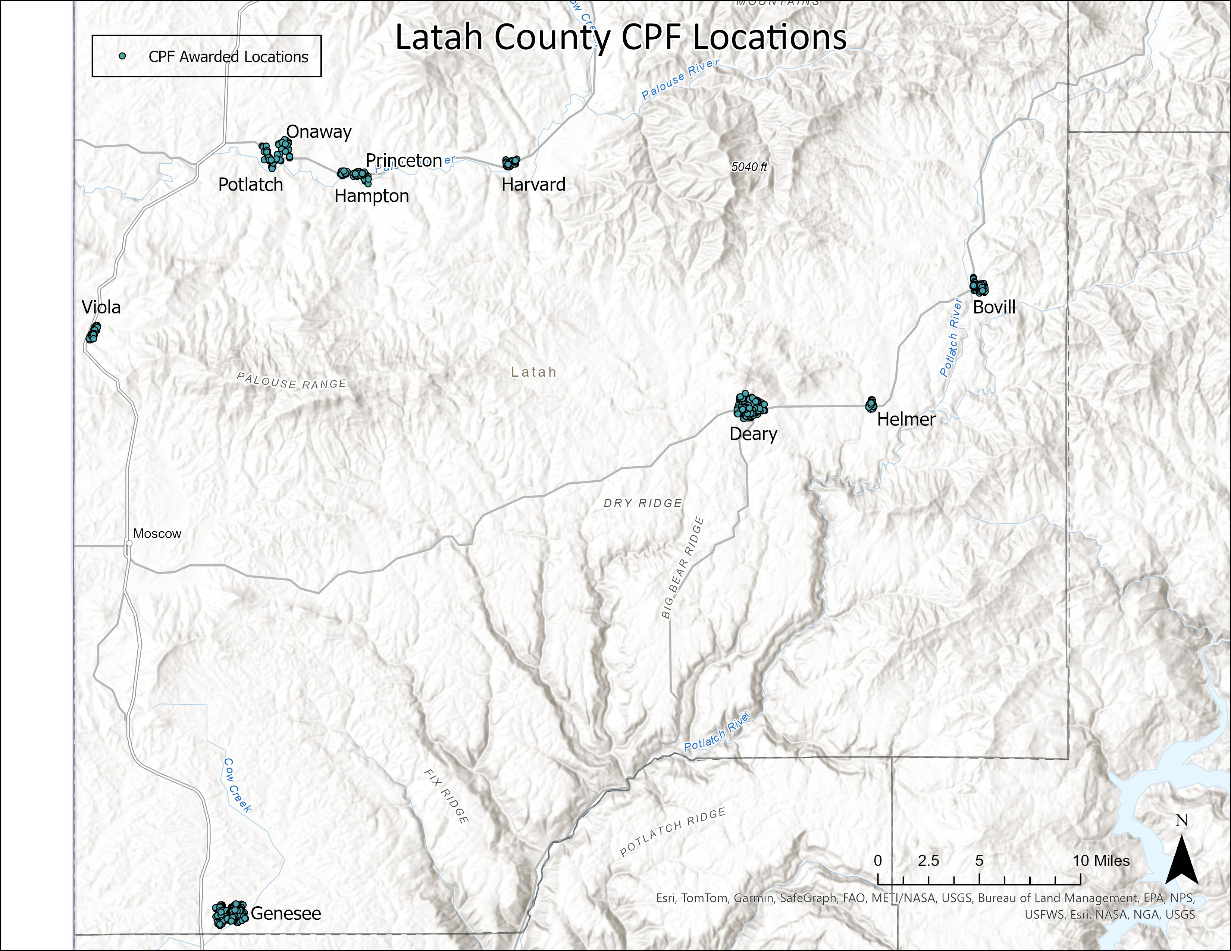

Latah County CPF BSLs

Slide 6
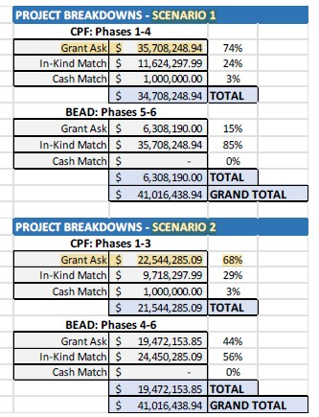
Latah Proposal/Application & Award
CPF Grant Request:
IBAB Award: $15,000,000

Slide 7
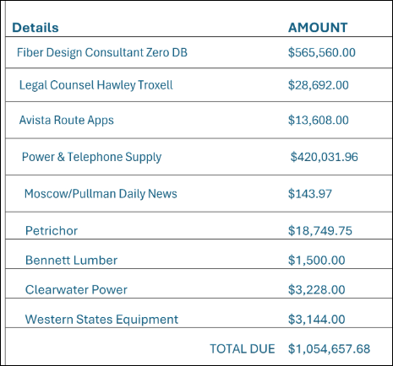
Current Project Stats
Grant Amount Awarded: $15,000,000.00
Match Commitment: $3,750,000.00 (25%)
BSL Commitment: 1,155
Grant Amount Award per BSL: $12,987.01
Funds Paid to Date After Reconciliation: $185,353.50
Funds Requested Pending Suspension Lift: $1,054,657.68

Slide 8
Current Project Status - Suspended
2026
January 21st: Project suspended
Given 30-day cure notice
February 20th: Cure due and submitted
March 3rd: Notice of review and IBAB meeting
March 25th: IBAB meeting

Slide 9
Curing Questions
(1) “…project does not demonstrate sufficient financial capacity to meet the required project match obligations …”
(2) “…in-kind match commitment currently includes approximately $1.6M for repeater sites within the County’s public safety communications system;…”
(3) “Work time tracking records…”
(4) “…not responded to timely requests from IOB auditors and has demonstrated inadequate record keeping practices…”

Slide 10
Project Risk Assessment Items
Insufficient Verifiable Project Match: The planned match contributions appear to be ineligible or obsolete, creating compliance and documentation risks and insufficiencies.
Unfinalized BSLs: Last‑mile locations yet to be formally confirmed; affects planning, reporting and eligibility.
Leadership/Team Changes: Departure of key personnel caused loss of project knowledge and continuity. Leadership also impacted by election cycles.

Slide 11
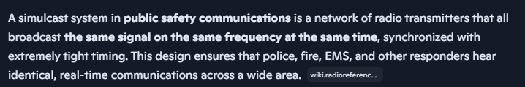
Risk Assessment Summary
Risk Item: In‑Kind Match Dependent on REPEATER SITES
The grant proposal included ~$1.6M in in‑kind match for County‑funded repeater site upgrades to the public safety Simulcast System on existing towers.
The proposal also assumed that CPF funds would connect these towers to fiber, keeping the in‑kind match aligned with federal requirements and the project as a whole.
Latah later changed the network design and removed fiber routes to the towers, which eliminated the connection pathway needed to support the original in‑kind match commitment.

Slide 12
Risk Assessment Summary
Risk Item: Insufficient Verifiable Project Match
Repeater sites, as presented and submitted, as in-kind project match deemed ineligible for CPF, under 2 CFR 200 and additional Federal CPF guidelines and requirements. Must be “necessary and reasonable for achieving the objectives of the Federal award…”
Insufficient match documentation submitted when requested, also short on cash match.
Proposed substitute in-kind match (IIG involvement) has no documentation, ownership structure is unclear, and may fall outside the scope of the project location.
Based on the above, the planned match contributions became ineligible or obsolete, creating compliance and documentation risks.

Slide 13
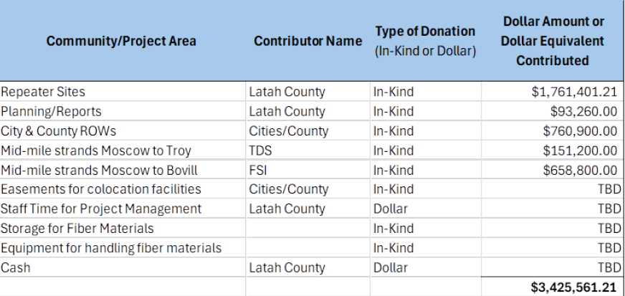
Risk Assessment Summary
Risk Item: Insufficient Verifiable Project Match

Slide 14
Critical Considerations
Does the Board believe the project is still able to meet the core grant requirements (BSLs, match eligibility, timelines) if continued, or has compliance risk become too much to overcome?
Should the subgrantee be given an additional opportunity to remediate the identified issues, and if so, under what expectations? What result would be satisfactory?
If the project continues, what specific conditions, safeguards, or risk thresholds must be met? This project has already been under a ‘corrective action’ plan since June 2024.
Does the Board want to waive any of the 25% match commitment?
Does the Board want to impose new project requirements that will ensure its successful completion?

Slide 15





QUESTIONS?
CONTACT US
commerce.idaho.gov commerce.idaho.gov/broadband
Idaho Commerce
@idahocommerce
Idaho Commerce
LinkUp.Idaho.gov
Ramón S. Hobdey-Sánchez Director
Idaho Office of Broadband Idaho Department of Commerce Office: 208.287.3153 ramon.hobdey-sanchez@commerce.idaho.gov

