Slide 1
Idaho Power and
Broadband Funding
Taylor Yost

Slide 2

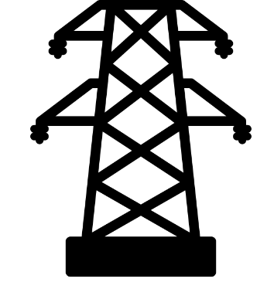
Idaho Power and Broadband
Total Structures
Attachments
Idaho Power safely accommodates attaching broadband on existing infrastructure - rural connection is key
Vertical real estate of poles owned are governed by “Facilities Attachment Agreements.”
Maintaining affordable electric rates = no cost shifting from broadband attachments to electric customers.
~447,800
Distribution
Poles
~156,796
Distribution
Attachments
~55,300
Transmission
Poles
~11,193
Transmission
Attachments
Notes:
Whether you’re a city, county or private internet service provider, Idaho Power is excited to support greater broadband access in the communities we serve. Because access to broadband connectivity correlates with economic growth and greater consumption of electricity, what is good for our communities is also good for our business. IPC must provide access to its poles while also maintaining Idaho Power construction standards and requirements of the National Electric Safety Code (NESC), with a primary focus on the safety of our licensees, contractors, our employees, and the public.

Slide 3




Joint Use Application Process
Application Submission
Assigned Designer & Fielding
Notify Customer of Cost
Cost Quote Submitted
1
2
3
4
IPCO processes and accepts/rejects depending on completion.
Designers validate licensee information and field every pole on the application.
Designers sends high-level cost option prior to assessing fees.
Cost quote and map sent reflecting all poles requiring make ready construction.

Slide 4




Joint Use Application Process Continued
Invoice
Make Ready Construction
Approved Application
Licensee Construction
5
6
7
8
If cost quote is accepted by the licensee, invoice provided.
Make Ready construction dependent on permits (ITD, Canal, RR) and permitting weather.
Designers provide instructional map and approved application upon construction completion.
Licensees notify IPCO of construction completion and IPCO inspector post inspects for violations.

Slide 5
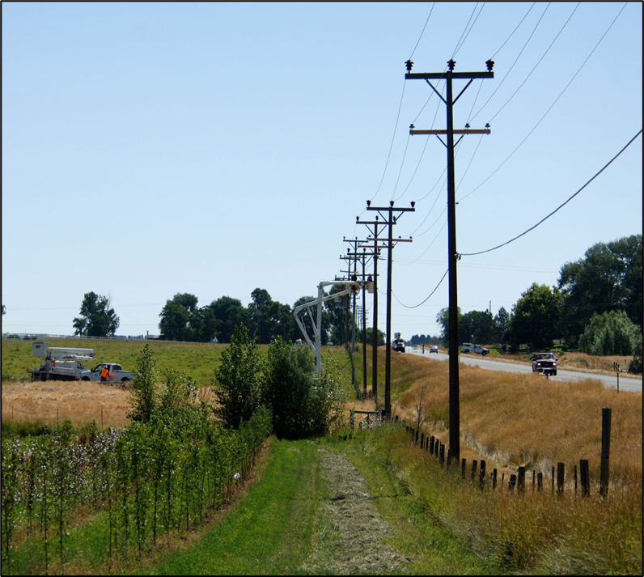

Idaho Code § 61-315
Preferential Treatment Prohibited
Applications queued based on date received.
Grant recipients to attach to poles within identified grant timeframes.
Regulations require non-preferential access to infrastructure and services.
Notes:
61-315. Discrimination and preference prohibited. No public utility shall, as to rates, charges, service, facilities or in any other respect, make or grant any preference or advantage to any corporation or person or subject any corporation or person to any prejudice or disadvantage. No public utility shall establish or maintain any unreasonable difference as to rates, charges, service, facilities or in any other respect, either as between localities or as between classes of service. The commission shall have the power to determine any question of fact arising under this section.
History:
[(61-315) 1913, ch. 61, sec. 18, p. 248; reen. C.L. 106:60; C.S., sec. 2427; I.C.A., sec. 59-315.]

Slide 6
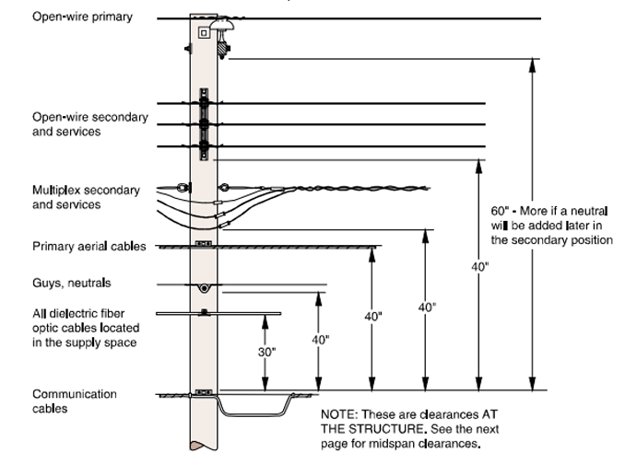
Idaho Power’s Challenges
Magnitude & Timing: new licensees and increased attachment requests.
Misunderstanding: lack of consideration for project-related engineering and make ready costs.
  Pole replacement costs ≠ utility negligence
  Pole replacements costs = clearances not being met or exceeding existing capacity

Slide 7

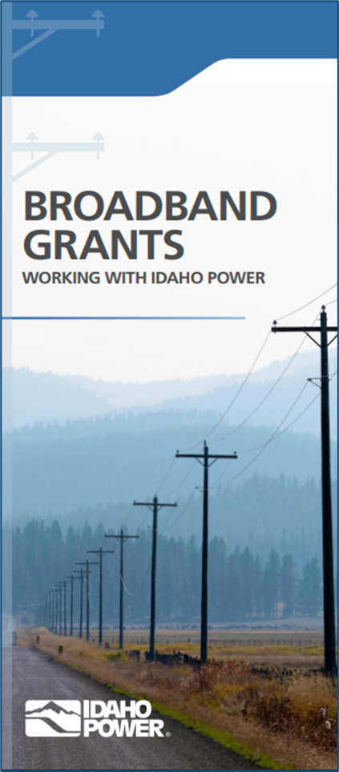
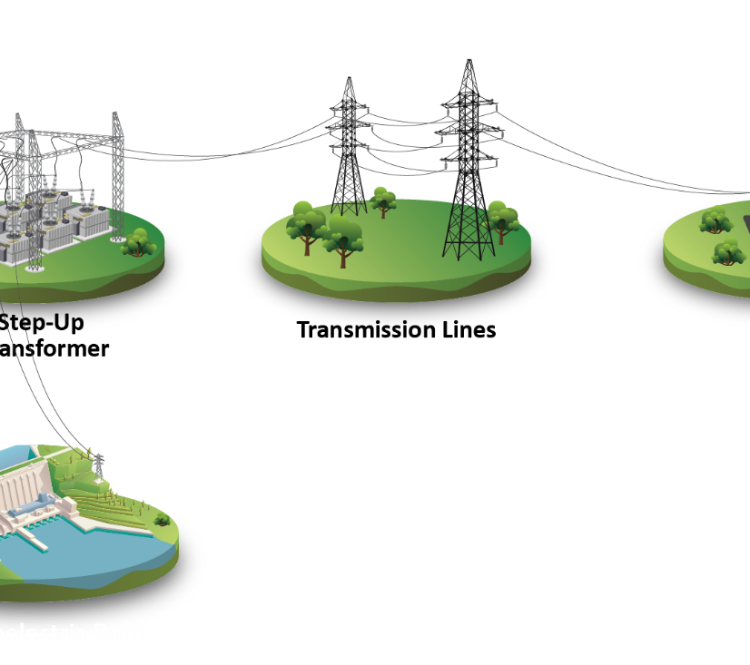
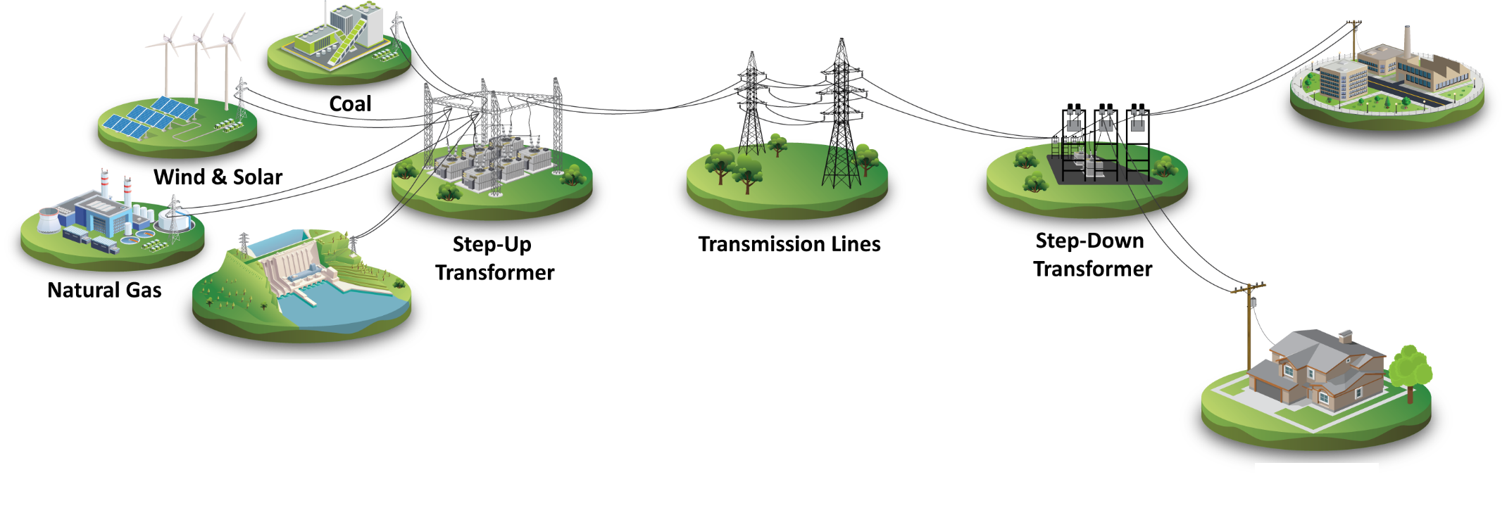
Preparing for Broadband
Idaho Power response:
  Adjusted department staff and utilized regional resources for fielding and design.
  Implementing new software for attachment submissions.
  Meet with licensees for alignment on standards and expectations, reducing project setbacks.
Licensees can find our grant brochure, related application submission and process documents online once they are awarded a grant.
https://idahopower.com/JointUse

Slide 8
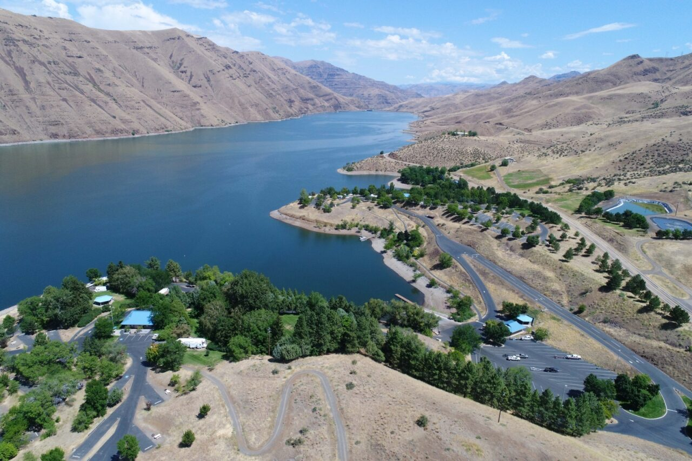
Idaho Power is a committed stakeholder and excited to support greater broadband access in the communities we serve.
Questions?

