Slide 1


Idaho Commission for Libraries Update
Idaho Broadband Advisory Board
December 2024

Slide 2
Why & What Is the ICfL?
A state agency, formed in 1901, with a mission to build the capacity of libraries to best serve their communities. ​
​The library community has been working on digital access for decades and are natural partners in these efforts.​
​100% in support and collaboration with the Governor’s Office, the Idaho Broadband Advisory Board, the Idaho Office of Broadband.

Slide 3
Digital Equity Act Programs
The federal Digital Equity Act (DEA) programs are funded by the Infrastructure Investment and Jobs Act (IIJA) with the BEAD program.
The DEA aims to ensure that all communities have the skills, technology, and capacity to reap the full benefits of our digital economy.
The Governor’s Office designated the ICfL as the administrative entity for the DEA programs.

Slide 4
Timeline
November 2022: $564,706 planning grant for the Digital Access for All Idahoans (DAAI) Plan.
October 2023: DAAI Plan submitted early and $180,145 under budget.
February 2024: One of the first six states to have a fully accepted plan.
October 2024: Third state to receive a capacity grant award for plan implementation.

Slide 5
Goals of the DAAI Plan
Increase adoption and affordability of broadband technology.
Improve online accessibility and inclusivity of public resources and services.
Increase digital skills.
Spread awareness of cybersecurity and online privacy.
Increase the availability and affordability of devices and technical support.

Slide 6
Idaho’s Capacity Funding
$6.3 million first state award.
$2.1 million each second and third awards expected for 2025 and 2026.
$10.5 million total estimated award.
$2.5 million in FY25 spending authority approved.
$2.5 million in FY26-FY29 ongoing spending authority requested.

Slide 7



Implementing the DAAI Plan
Subgranting more than 80% to eligible entities.
  State agencies, community anchor institutions, workforce, and adult education organizations.
Remaining funds for statewide programs.
  IdahoDigitalSkills.org, digital navigators, and website accessibility.

Slide 8
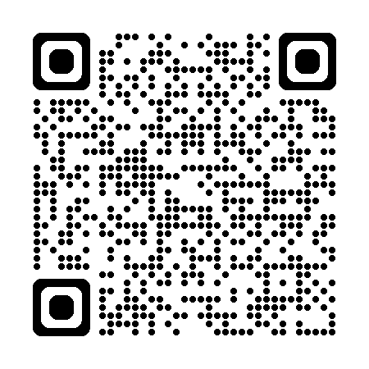
Contact Us
Stephanie Bailey-White, director
208-639-4145 | Stephanie.Bailey-White@libraries.idaho.gov
Dylan Baker, deputy state librarian
208-639-4167 | Dylan.Baker@libraries.idaho.gov
https://libraries.idaho.gov/daai

