Slide 1
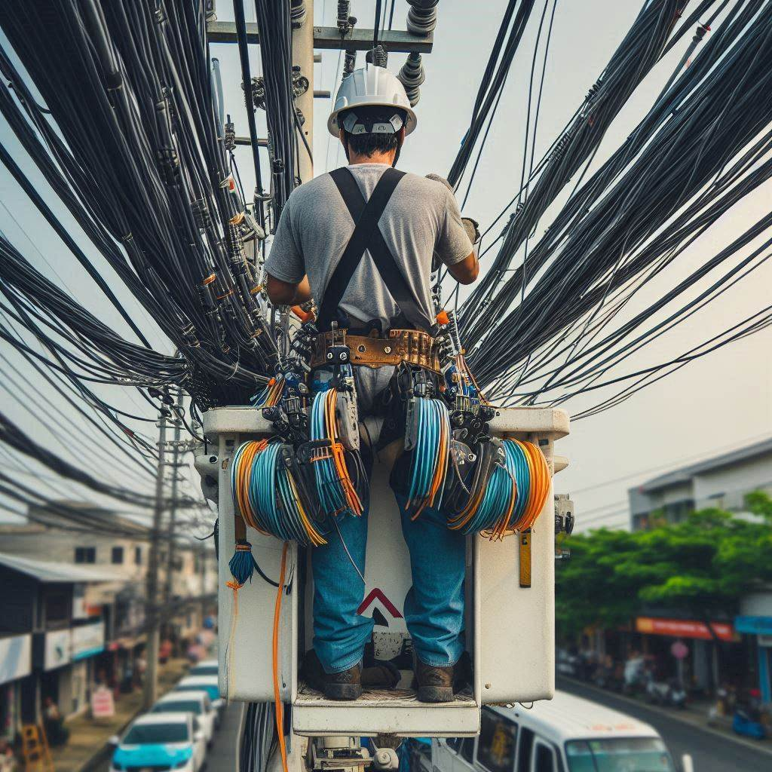
Joint Use Program & reacting to the “Broadband Tsunami”
Jesse Butler/Scott Meredith

Slide 2
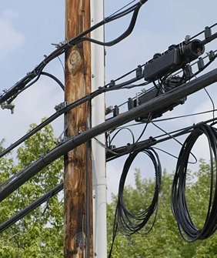
What is “Joint Use”?
A utility pole owner facilitating 3rd party attachments for public services, telecom entities, etc.
Three key state laws set the field of play for Joint Use:
Avista is required to facilitate attachment requests within certain timelines – Cooperation
Avista must ensure that all poles targeted in an attachment request are brought up to current National Electric Safety Code – Safety
Avista must ensure that all costs associated with attachment requests (including electric construction work) are born by the requestor, protecting ratepayers from subsidizing telecom construction – Protecting Ratepayers
External Partners & Fire Professionals
Internal Employees

Slide 3
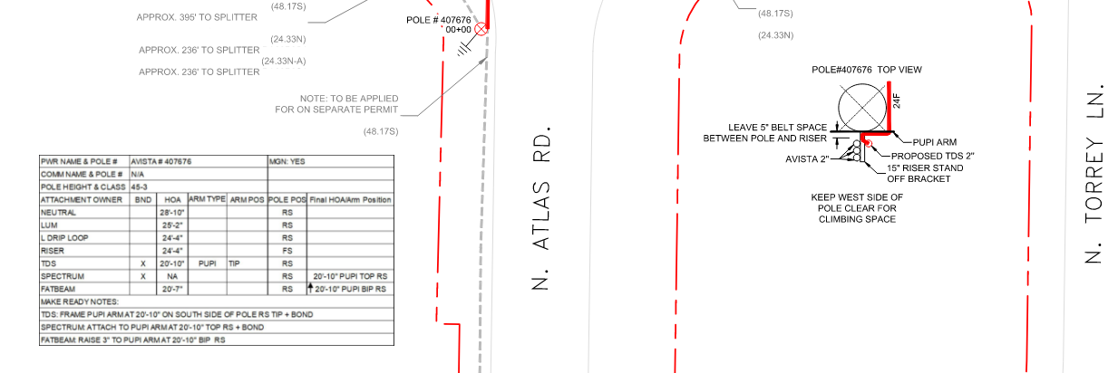
How an attachment request works
A licensee (a company with an attachment agreement with Avista) identifies where they want to go utilizing Avista poles
The licensee engineers a technical design outlining pole locations, proposed attachment heights, cable to be installed, identifies code violations, etc.
They submit this design and an application form to the Joint Use team

Slide 4
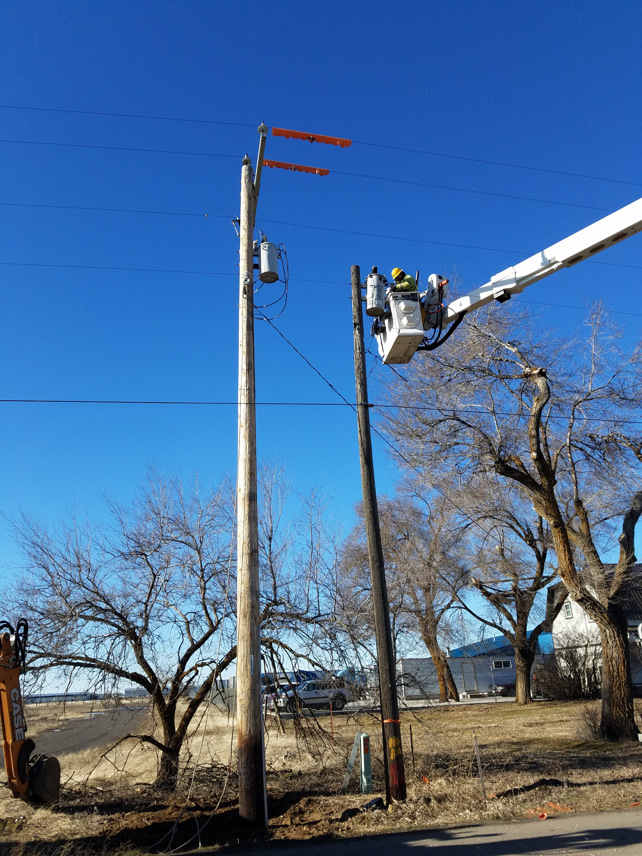
How an attachment request works (continued)
A Joint Use CPC will field survey each pole, note the minimum construction work needed to ensure NESC compliance, evaluate pole loading, and revise design plan as needed
Avista does not pass along costs due to pole age or condition, only the costs strictly required to ensure the poles are safe to access and can bear the weight of the new facilities
The CPC informs the applicant of predicted construction costs. Upon agreement from the applicant to pay those costs, the CPC coordinates the construction work

Slide 5
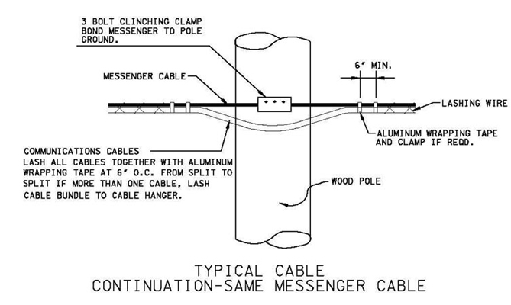
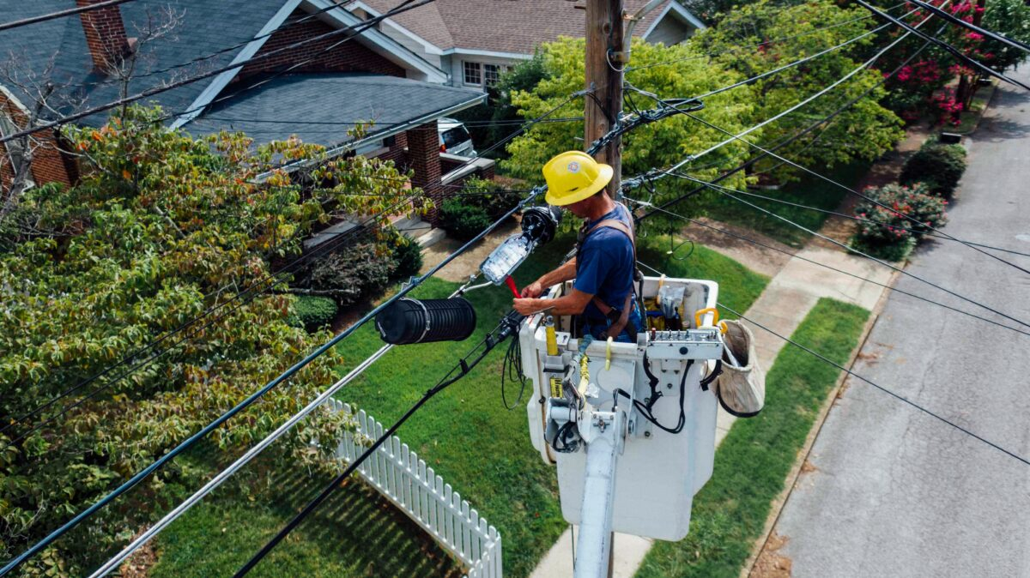
How an attachment request works (continued)
Upon completion of the Avista work, the application is approved, and the applicant can install their cables
External Partners & Fire Professionals

Slide 6

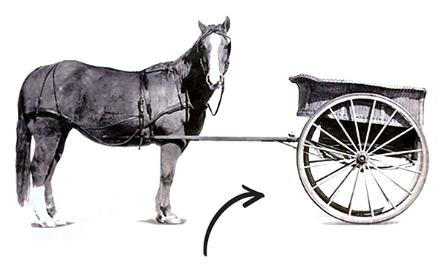
Prepared Response
Avista must ensure it has the personnel in place to process and permit any project a legitimate licensee submits
Avista must also ensure that the costs associated with processing these projects is born by the licensee
We play a “cart and horse” game trying to balance the resources to handle broadband growth, but not incurring costs that would be born by ratepayers
2013 | 2024
Avista | Avista
 | Potelco
 | Legal Support
Total 2 | Total 21

Slide 7

The “Broadband Tsunami”
Has Arrived

Slide 8
Grant Funding
BEAD (Broadband Equity, Access, and Deployment) – $42B
WA State over $1.2B
ID State over $650M
State & federal agencies consider broadband “essential to modern life”
Targeted areas have historically been a bad business case for service providers
The construction costs to make rural pole leads safe and viable for new fiberoptic attachments are very high
Grant recipients are often unaware of associated costs to bring up to code

Slide 9
Successful Outcomes
10,700+ poles currently in application process
TDS – Overbuild of Spokane, CDA/PF
Highly cooperative relationship, excellent communication, has targeted Avista territory for further growth due to rapid, successful deployment (approx. 6,000 poles)
Adams County
Successful partnership, deployment in progress in Ritzville, Lind, Washtucna, Othello (approx. 630 poles)
Lincoln County
Successful partnership, deployment in progress in Almira, Wilbur, Creston, Harrington, Reardan, Davenport, Odessa, Sprague (approx. 1,650 poles)

Slide 10
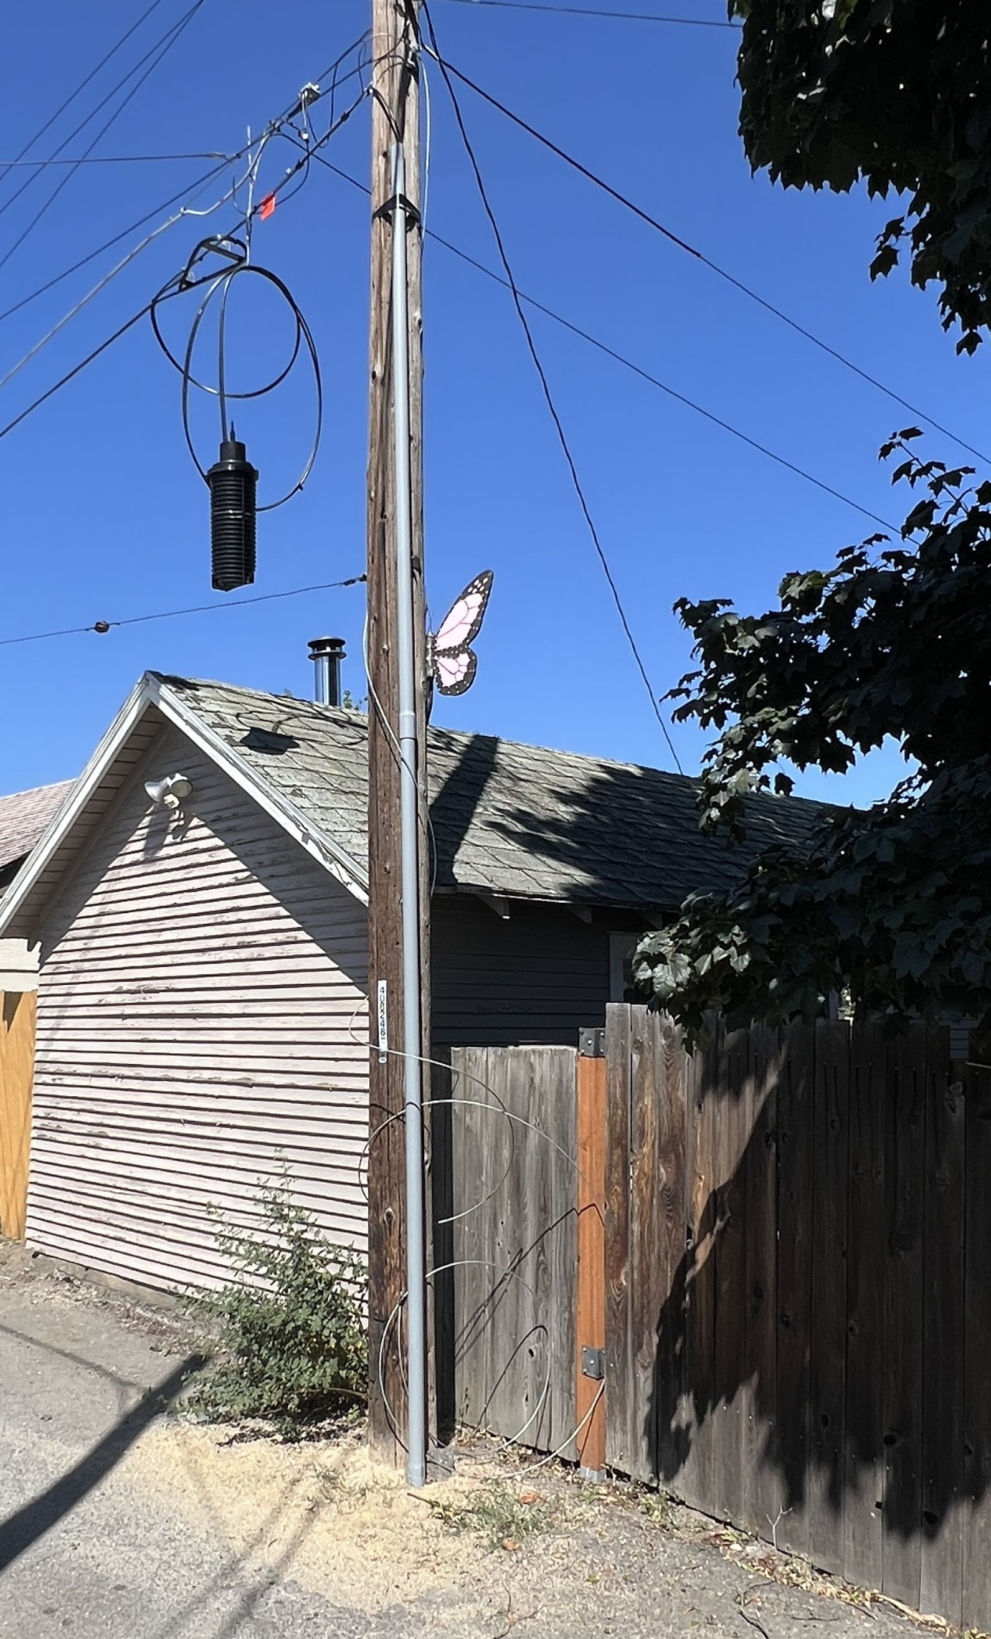
Challenges Experienced
Out of state contractors created numerous safety issues – Avista issued work stoppages
Contractor budgeted $100 per pole in make ready - $2M reality
Did not budget for make ready, unaware of WUTC/IPUC laws
Used numerous design contractors of varying quality leading to permit delays

Slide 11
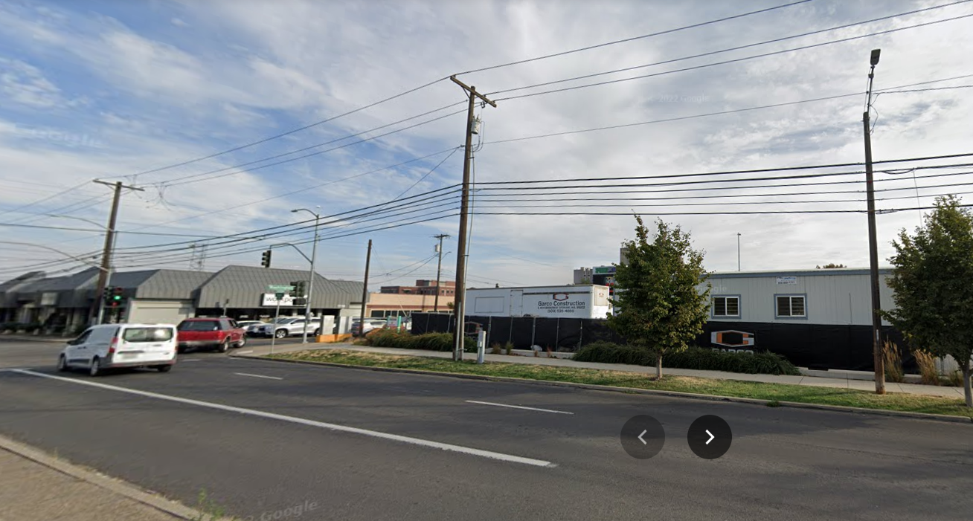
Urban poles, viable for Joint Use

Slide 12
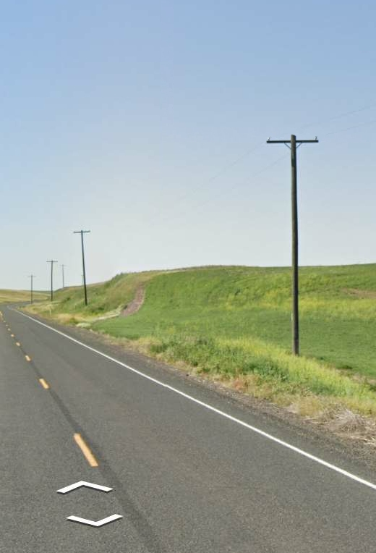
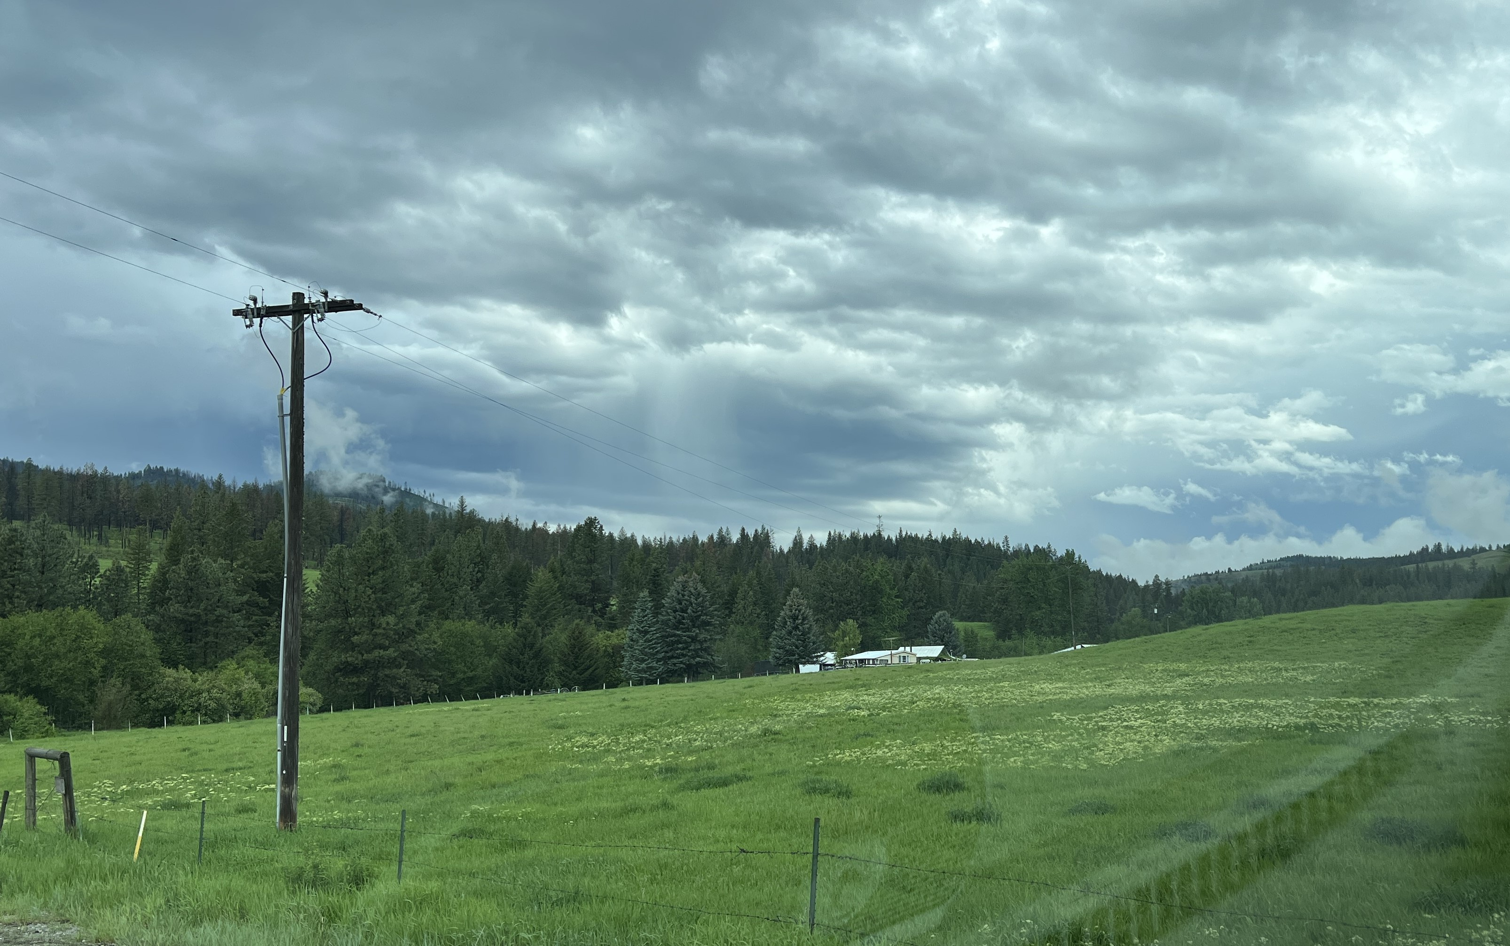
Rural poles, challenging for Joint Use

Slide 13
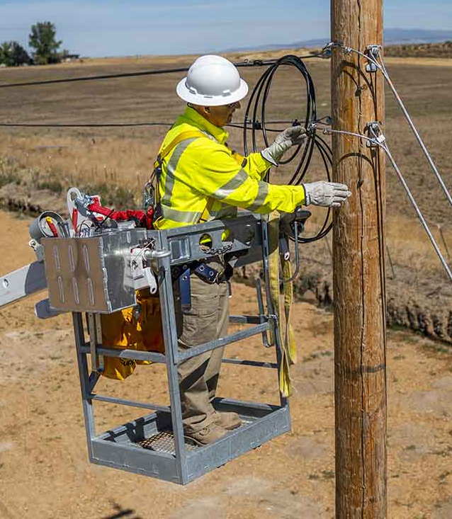
Proactive Steps
Avista is balancing the timely deployment of these projects and our duty to protect our ratepayers
Increased involvement with state broadband offices, utility commissions, etc.
Stand out as effective partners with communities and gov’t agencies
Avista is playing a very real role in connecting and revitalizing many rural communities that are benefitting from these projects

Slide 14
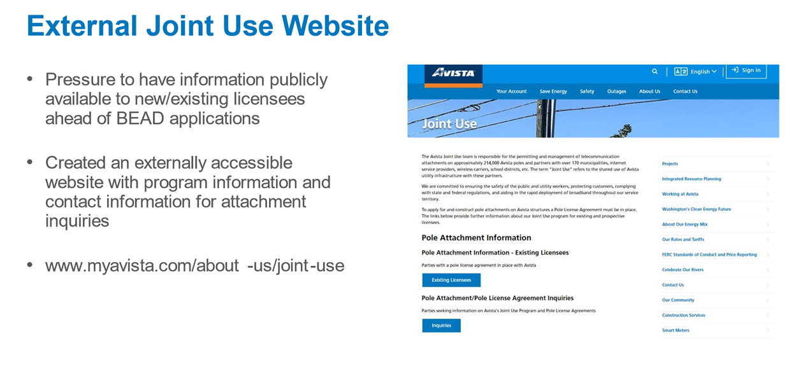
Proactive Steps

Slide 15
Questions?

