Slide 1
Welcome
Notes:
Hi, everyone. I want to do a little bit of audience participation. How many of you have heard of PBS? Idaho Public Television? What do you think of when I say PBS?

Slide 2
Idaho Public Television harnesses the power of public media to encourage lifelong discovery, connect our communities, and enrich the lives of all Idahoans. We tell Idaho’s stories.
Our Mission
Notes:
We are not just a tv network. In fact, we are an education and entertainment media delivery system. And we are storytellers.

Slide 3
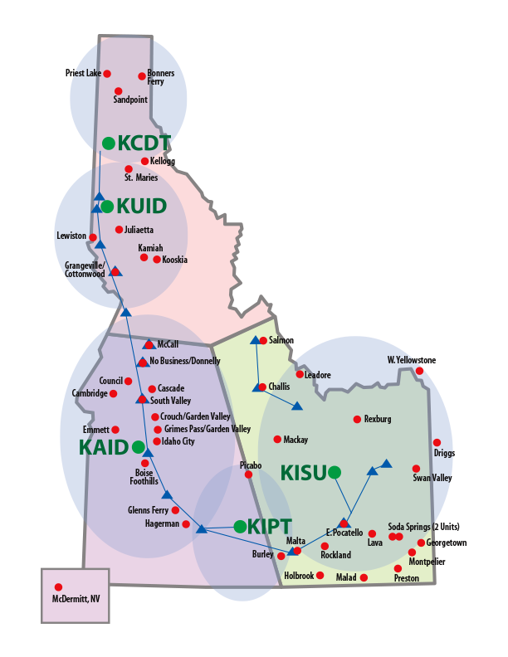
Reaching Nearly
100% of
Households!
5 Transmitters
47 Repeaters
Studios in Each Region
Notes:
We reach all corners of Idaho with our broadcast signal thanks to an extensive network of transmitters and translators

Slide 4
IdahoPTV Reaches a Broad Audience
More than 460,000
Idahoans watch
Idaho Public Television in an average week.
20,000
active
donors
100 sponsors
Source: Nielsen 2015
Notes:
IdahoPTV Reaches a Broad Audience Try to Find Updated Number

Slide 5
Online Access via Desktop & Mobile
iOS & Android Apps; Roku, Chromecast, Xbox, AppleTV Channels
Notes:
Our programming, both national and local, is now available on all the new platforms from your cell phone and tablets, to streaming boxes such as Roku, Chromcast and AppleTV

Slide 6
Among the most-watched PBS stations in US, per capita
Source: Feb. 2012-2017, TRAC Media, Total Ratings
Notes:
Consistently #1 Most-Viewed PBS Station

Slide 7
Award Winning Productions
60 International, National & Regional Awards
Notes:
Award Winning Productions

Slide 8
March 2018
Notes:
Idaho Experience

Slide 9
Early 2018
Notes:
PBSKids 24/7

Slide 10
Into the Pioneers
December 3rd
Notes:
Outdoor Idaho: Into the Pioneers

