Slide 1
Sojern
Idaho Travel Council Grant Summit
10/17/2017

Slide 2
Travel’s Direct Demand Engine
Specializing in traveler path-to-purchase data for over a decade, Sojern activates multi-channel branding and performance solutions built on predictive data science, billions of search and booking intent signals, and real-time analysis of the world’s traveler profiles.
Partner with us to experience the difference in our results and see how we help deliver $10B+ in generated bookings for our clients each year.

Slide 3
Sojern Traveler Platform
Travel Partners
Purchase Behavior
Demographics
Mobile Activity
Response Data
Profile Store
Profile Mapping Loyalty Status
Travel Intent
Purchase History
Post Campaign Reports
Data Ingestion
Decision Engine
Data Warehouse
API
Profile Scoring
Modeling
Budget Allocation
Audience Classification
Machine Learning
Creative Rules
API
Custom Insights
Multi-Bidder Approach
Sojern Bidder
3rd Parties
DISPLAY
MOBILE
VIDEO
EMERGING CHANNELS
NATIVE
PMP

Slide 4
Data-Driven Marketing
Identify the Right Data
Build Your Audience
Engage & Convert
Actionable Insights
Through our strategic partnerships we build our profiles to decipher the where, when, and why people plan to travel.
Activating this data to find your in-market travelers, the Sojern Traveler Platform drives campaign performance.
Our learning algorithms continuously optimize for targeting and conversions as we message across channels where travelers engage.
Our reporting suite provides data-driven insights to inform future business decisions.
Right Message + Right Format + Right Traveler + Right Time

Slide 5
Sojern is the first and only travel company to become a DoubleClick Certified Marketing Partner

Slide 6
Benefits for our Valued Customers
Access to New Inventory
More Ways to Target
Partner Peace of Mind
YouTube TrueView inventory can only be accessed programmatically through a direct partnership with DoubleClick.
Native Ads allows your ad to look, act and feel like part of the content. Currently in alpha testing.
Keyword Contextual Targeting (KCT) serves ads based on the content of the page of the site.
Affinity Targeting reaches audiences based on their specific interests, such as “luxury shoppers” or “family vacationers.”
Beta Access so you can be one of the first to test new DoubleClick products.
Expert Resources so your campaigns always stay on the cutting edge.
Exclusively Powered by Sojern’s travel intent data across the full suite of DoubleClick’s ad product offerings.

Slide 7
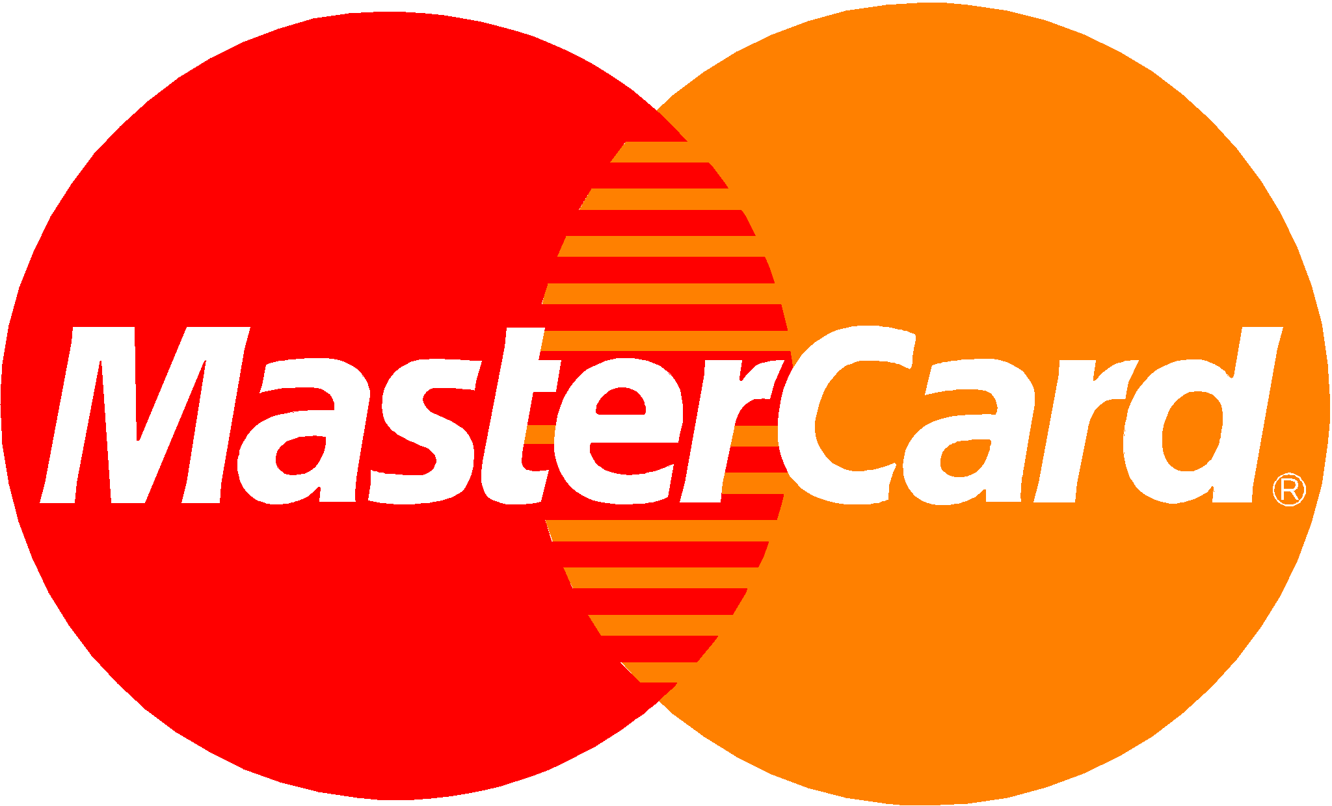
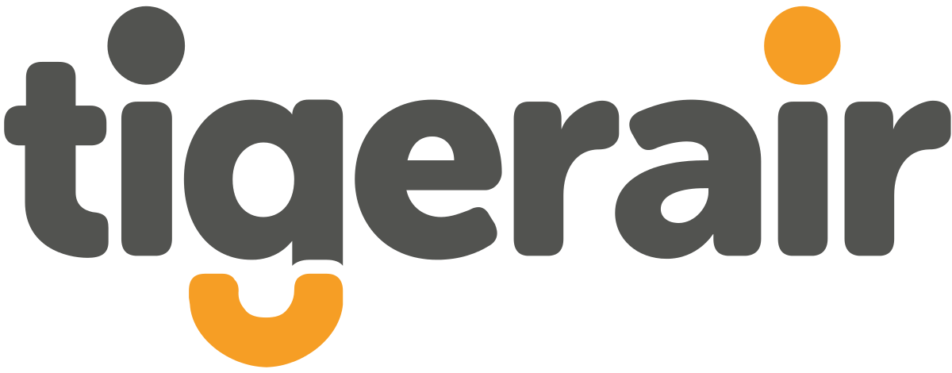
Who We Work With
Partnerships with 800+ Top Global Brands

Slide 8
Data is the base of our partnership.
No extra costs to have access to all our Data Insights, Custom Analytics, Reporting.
Destination Infographics
Post Impression Travel Conversions & ROAS study
Future Forecasting and Website Analytics
Custom Insights
Using our unique travel search and booking partner data, we report per market on travel behavior
Travel search and booking behavior and economic impact as direct result of media spend
Identify DMOs website positioning in the travel planning process; Forecast future visitation
Utilizing our travel data, Sojern is able to provide custom insights to assist with future campaign planning as added value.

Slide 9
Device Lead Time (in Days)
From US IPs to Idaho
Source: Sojern Internal Data, US IP, January 2017 - September 2017

Slide 10
Post Campaign Analytics

Slide 11
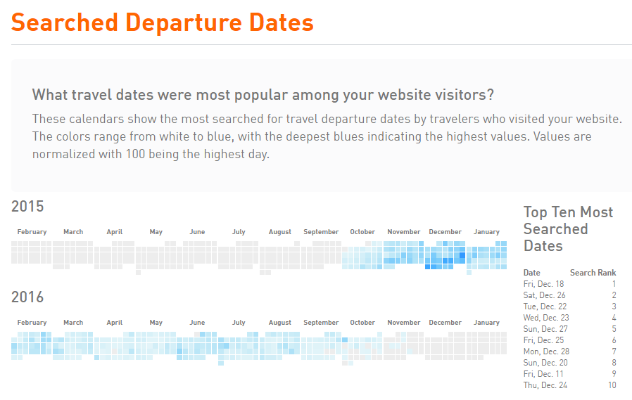
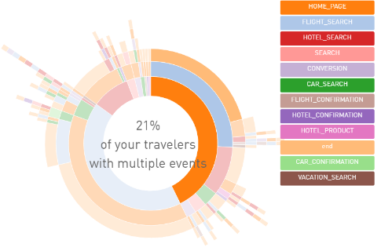
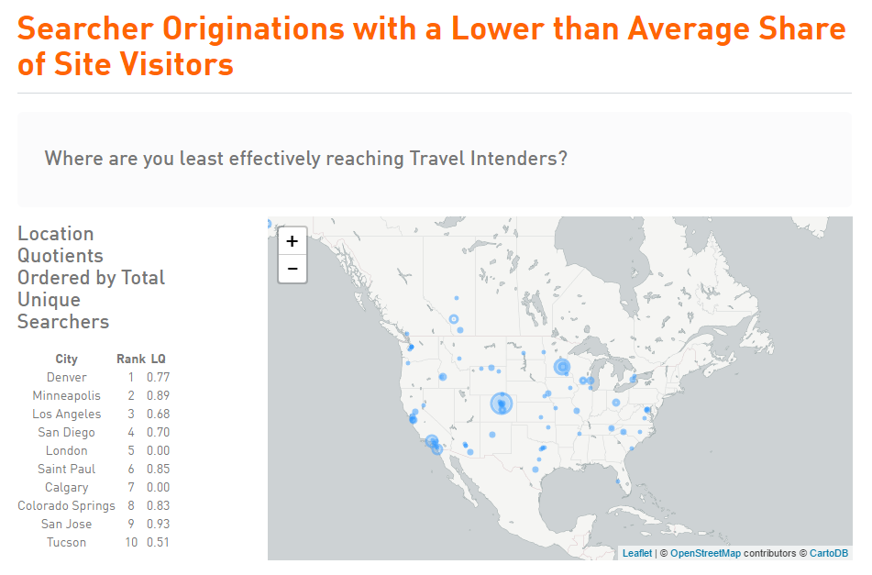
Customer Profile Report
We help you understand your customers

Slide 12
Why Sojern?
Dedicated Tourism Team
Strong Performance Record for Destinations & Attraction
Stellar Customer Service
Culture of Excellence
Added Value
Data Insights
Proactive Optimization & Campaign Reporting
Notes:
Travel: We understand the problems you’re trying to solve and build out solutions that work for you. Our solutions are aligned with your needs. We find the strategic data that will perform.
Tech: We’ve built the best travel-specific platform out there, that performs for you.
Team: Proof is in the pudding.
Travel + Tech + Team = Performance for You – We’ve driven $1B bookings, 2.2M heads in beds, 1.2M travelers in seats.

Slide 13
THANK YOU
Meredith Dillon
Sales Director, Tourism
meredith.dillon@sojern.com
312-480-0056

